Slide 1
Unit 7-1 Areas of Parallelograms and Triangles
PLANE Geometry

Slide 2
Area of a Parallelogram:
The Area $A$ of a Parallelogram is the Product of a Base $b$ and its corresponding Height $h$.
$$A=bh$$
$$h$$
$$b$$

Slide 3
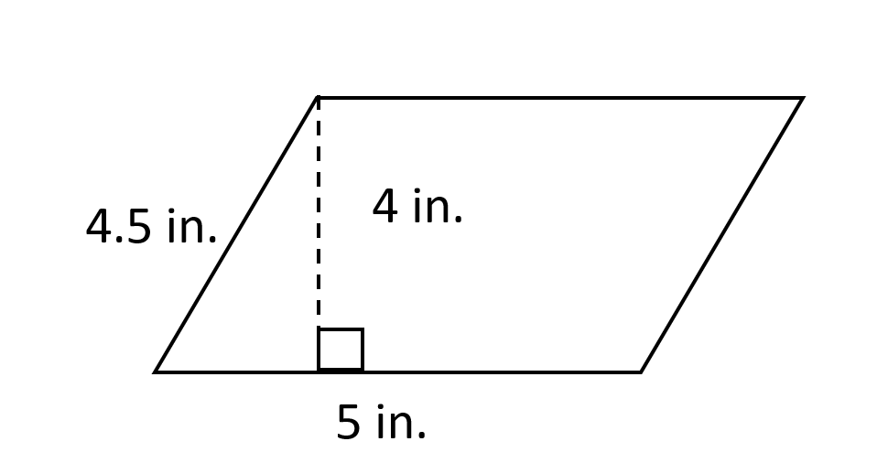
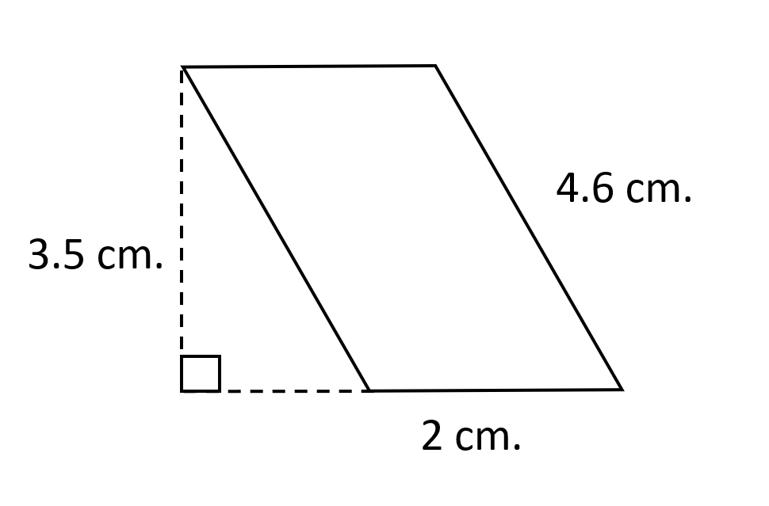
Example 1: Find the Area of the Parallelogram.

Slide 4
Example 2: Find the Missing Base or Height.
$A=$240
$$A=54$$
$$12$$
$$h$$
$$b=9$$

Slide 5
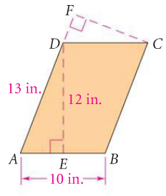
Example 3: Find $CF$.

Slide 6
Area of a Triangle:
The Area $A$ of a Triangle is One Half the Product of a Base $b$ and its Corresponding Height $h$.
$$A=\frac{bh}{2}$$
$$h$$
$$b$$

Slide 7
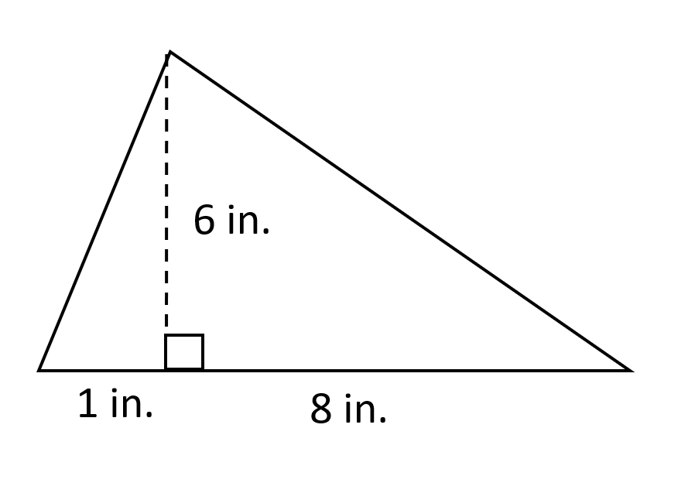
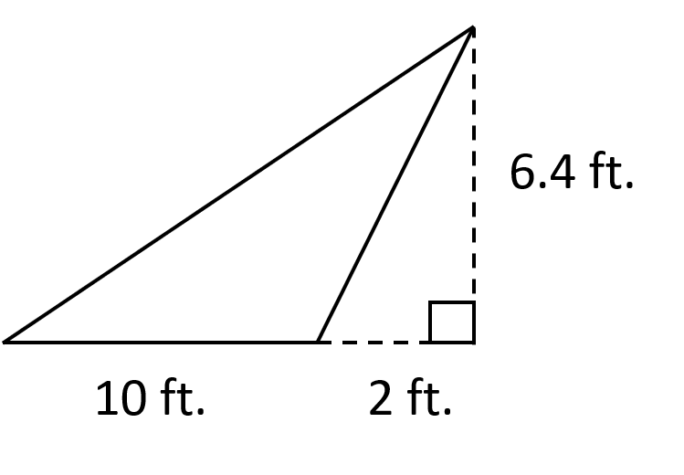
Example 4: Find the Area of the Triangle.

Slide 8
Example 5: Find the Missing Base or Height.
$$A=52$$
$$A=56$$
$$8$$
$$h$$
$$b$$
$$7$$

